Slide 1
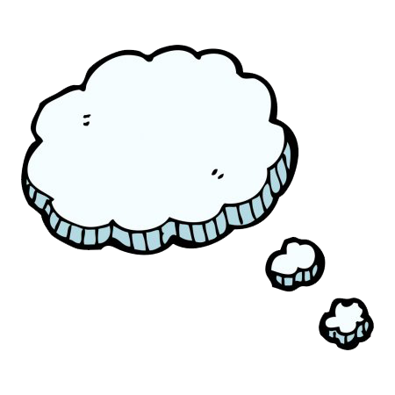
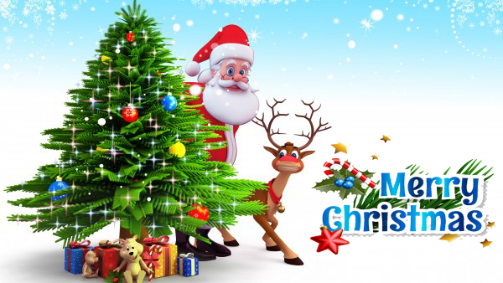
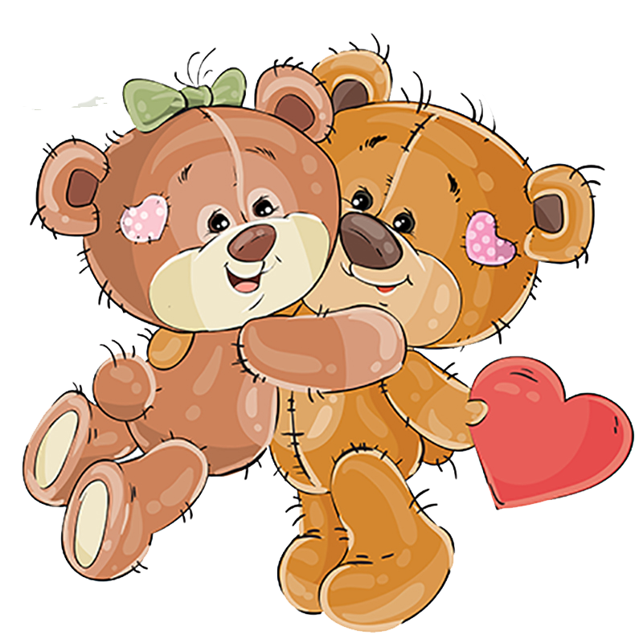
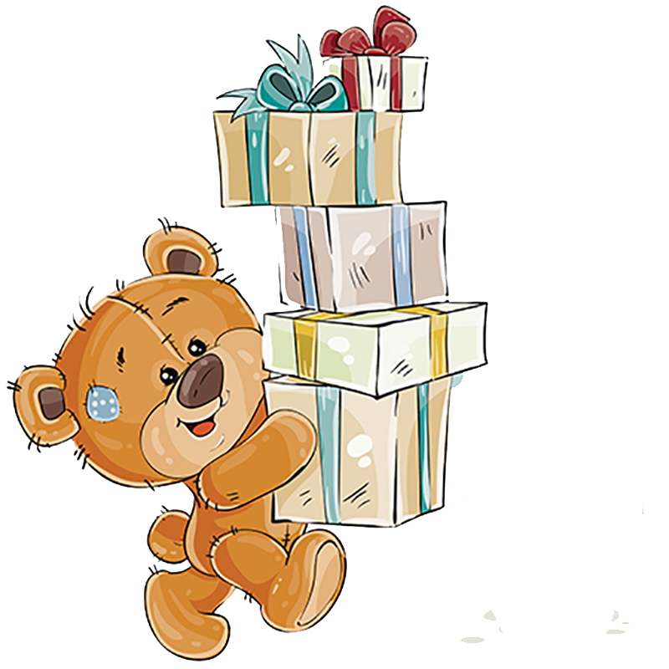
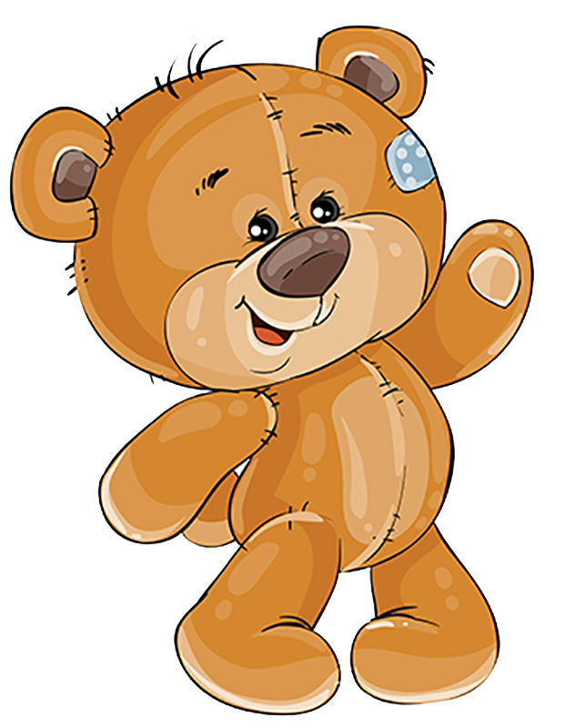
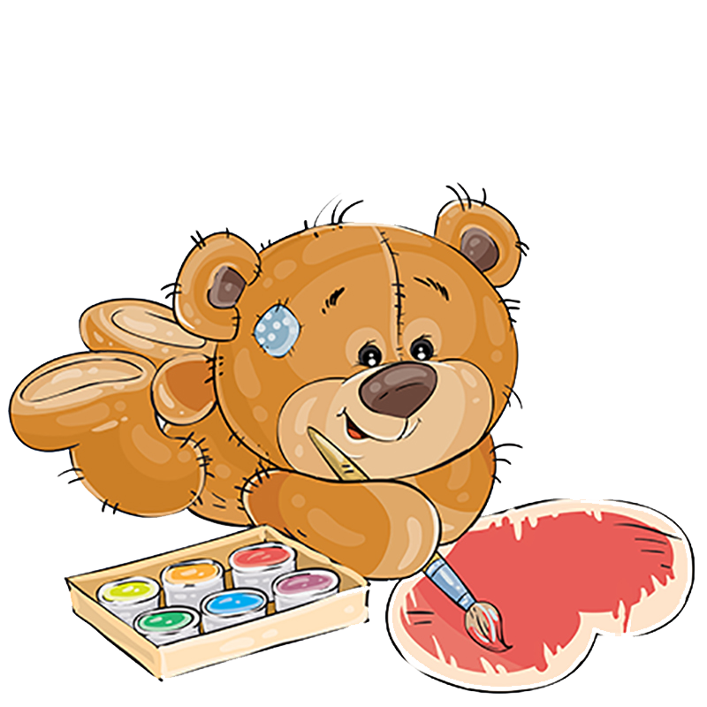
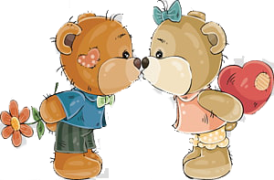
Then Little Bear said
Little Bear looked up in surprise as he was finishing the painting of his great grandpa bear, just two days before Christmas
He paused a few seconds thinking at the last brush stroke and said
Then he announced that the last of all the gifts had been made and in time for Christmas, which was only two days away…
I guess that I do not need anything!
For I have all that any little bear could ever want!
Click me
…and lots of love!
…kisses
I have hugs…
The End
and
Happy New Year!

